Slide 1
PQ-Man
Pablo Berenguel, Anthony Andrianjatovo, Najib Kardjoudj, Mathieu Sanchez, Quentin Noël

Slide 2
Timeline
Week 1 : Deciding of the tools, starting parsing the HTML pages
Week 2 : Getting the contents of articles, and opening a Github
Week 3 : Calculating the TF.IDF and ranking the articles
Week 4 : Implementing the Web interface

Slide 3
Introduction
Allows users to get the most relevant sport article.
Get articles from multiples sport news websites.
Better results with specific research (only keyword)

Slide 4





Development and programming Tools
JAVA language
Jsoup Library to parse HTML
Spark Server
Angular 8
Github
Docker

Slide 5
How it works
Keywords typed by user
Connection to web sources, parsing and retrieving the HTML content
Computation of term frequencies and inverted document frequencies
Ranking of the articles based on the TF.IDF result

Slide 6
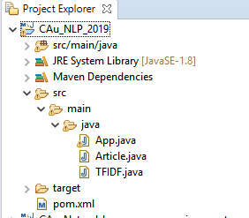
Architecture
Main program parsing websites and calculating TF.IDF
Web Interface using Angular 8
Server Java for the web interface

Slide 7
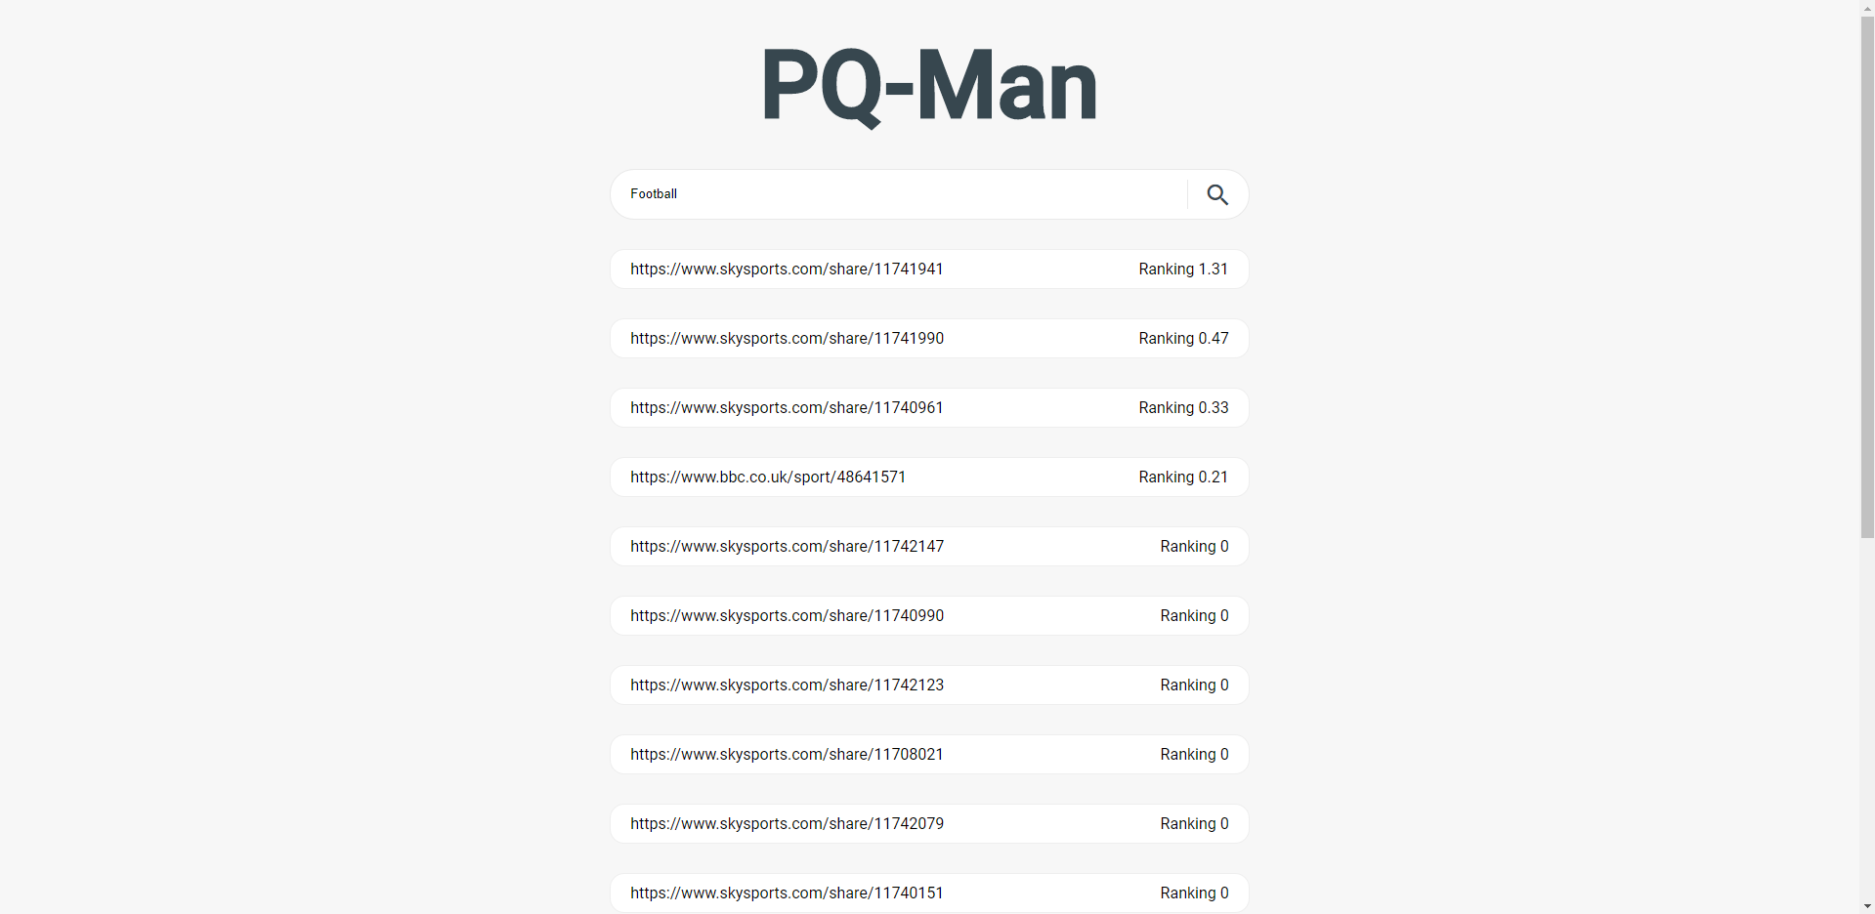
Results

Slide 8
Demonstration

Slide 9
Thanks for listening !
https://github.com/PabloBerenguel/CAu-Natural-language-processing

